Slide 1
Evaluating US Food Insecurity
By Josh Forster

Slide 2
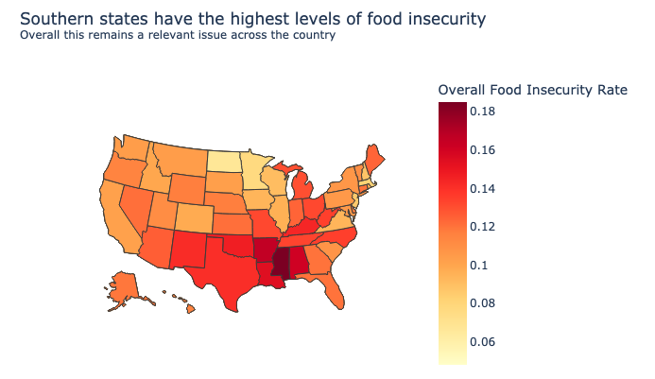
Mapping US Food insecurity

Slide 3
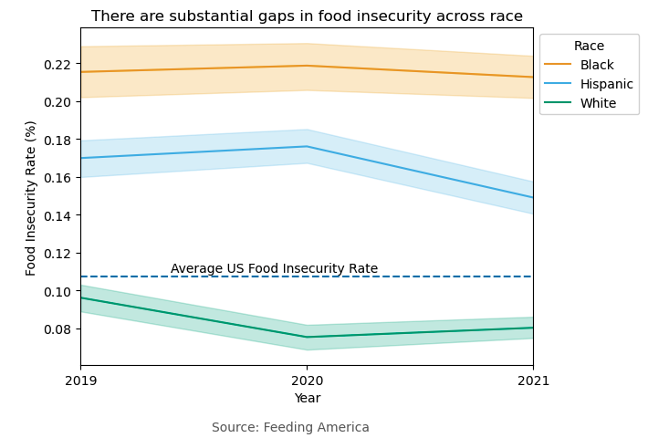
Race and Food Insecurity

Slide 4
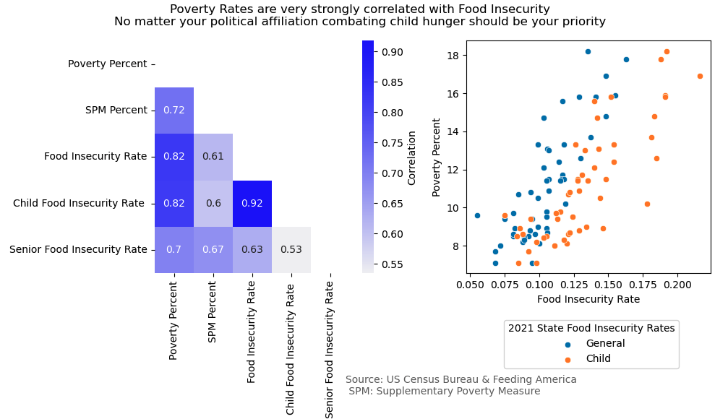
Poverty and Food Insecurity Strongly Linked

Slide 5
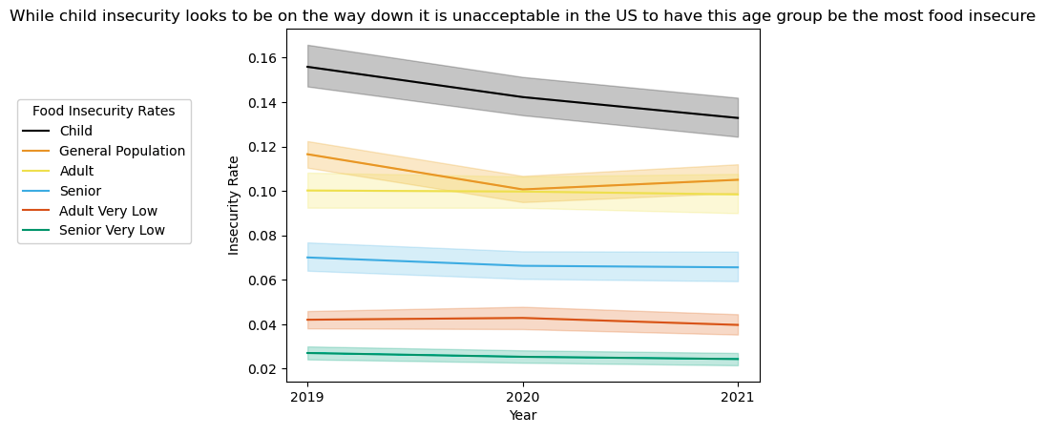
Age and Food Insecurity

Slide 6
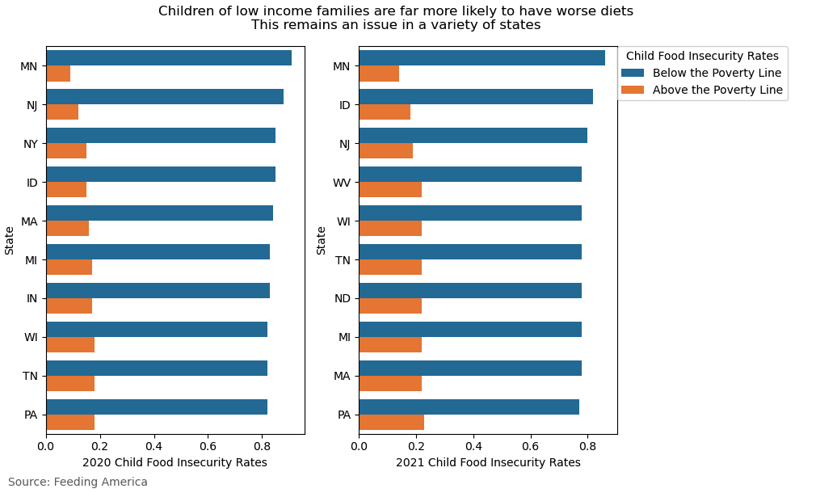
Exploring Child Food Insecurity vs Income

Slide 7
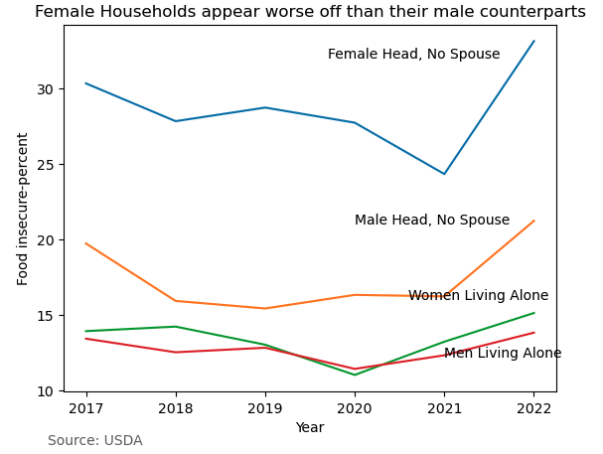
Gender and Food Insecurity

Slide 8
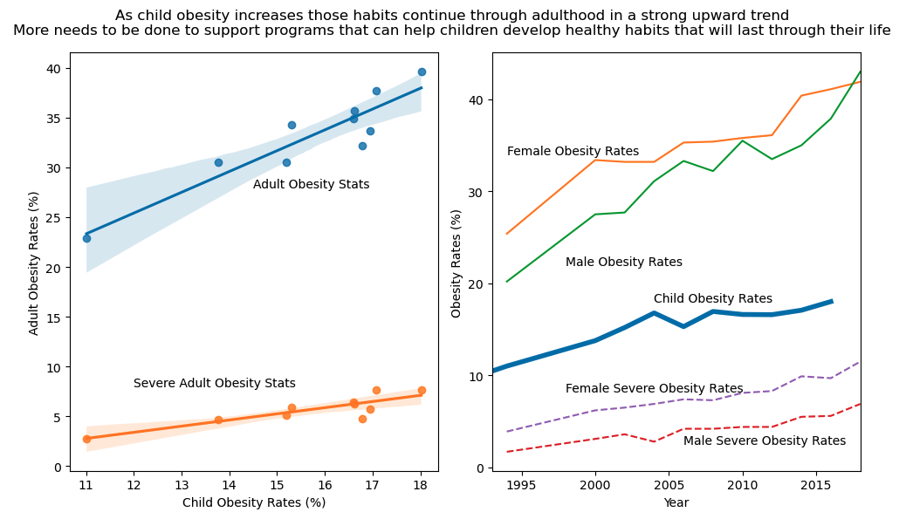
Early food insecurity impacts future citizens

Slide 9
Sources
https://www.cdc.gov/nchs/data/hestat/obesity-adult-17-18/obesity-adult.htm
https://www.epa.gov/americaschildrenenvironment/americas-children-and-environment-data-tables
https://www.cdc.gov/nchs/products/databriefs/db465.htm#:~:text=Key%20findings-,Data%20from%20the%20National%20Health%20Interview%20Survey,%25)%20than%20men%20(5.2%25).
https://peerta.acf.hhs.gov/content/long-term-health-consequences-childhood-food-insecurity
https://frac.org/wp-content/uploads/hunger-health-impact-poverty-food-insecurity-health-well-being.pdf
https://nccd.cdc.gov/dnpao_dtm/rdPage.aspx?rdReport=DNPAO_DTM.ExploreByTopic&islClass=OWS&islTopic=&go=GO
https://www.census.gov/library/publications/2023/demo/p60-280.html#:~:text=Highlights-,Official%20Poverty%20Measure,and%20Table%20A%2D1).
https://www.dailykos.com/stories/2020/11/19/1163009/-Daily-Kos-Elections-presidential-results-by-congressional-district-for-2020-2016-and-2012
https://public.opendatasoft.com/explore/dataset/us-county-boundaries/export/?flg=en-us&disjunctive.statefp&disjunctive.countyfp&disjunctive.name&disjunctive.namelsad&disjunctive.stusab&disjunctive.state_name&sort=countyfp
https://www.ers.usda.gov/topics/food-nutrition-assistance/food-security-in-the-u-s/interactive-charts-and-highlights/#trends

